Slide 1


Empowering Early Detection through Breast Cancer Prediction
Unveiling Patterns, Enabling Precision:
A Data-Driven Approach for Improved Breast Cancer Predictions
By: Aarti Ramani Date: 08/09/2023
DSC630-T301 Predictive Analytics (2237-1)
Notes:
Hello! My name is Aarti Ramani and today I welcome you to the presentation on a critical exploration of breast cancer prediction using advanced data analysis techniques. I'm thrilled to share with you the discoveries and insights gained from the deep dive into predictive modeling for one of the most prevalent health concerns of our time.

Slide 2

INTRODUCTION
Breast cancer, a complex and multifaceted disease, demands meticulous analysis and proactive interventions. Breast cancer is a particularly concerning type of cancer that affects cells within the breast tissue. It is a significant health issue for women but can also impact men.
In an era driven by technological advancement, the realm of healthcare is witnessing a transformative shift with the integration of machine learning. This project embarks on a journey to leverage the power of predictive modeling to enhance the early detection of breast cancer, a pressing concern that deeply impacts the lives of countless individuals.
Notes:
This intricate and multifaceted disease warrants meticulous analysis and proactive interventions. It not only impacts women but also affects men. In our rapidly advancing era, where technology is reshaping every facet of our lives, the integration of machine learning is revolutionizing healthcare. Our journey today embarks on utilizing predictive modeling to significantly enhance the early detection of breast cancer, a concern that deeply affects the lives of countless individuals.

Slide 3
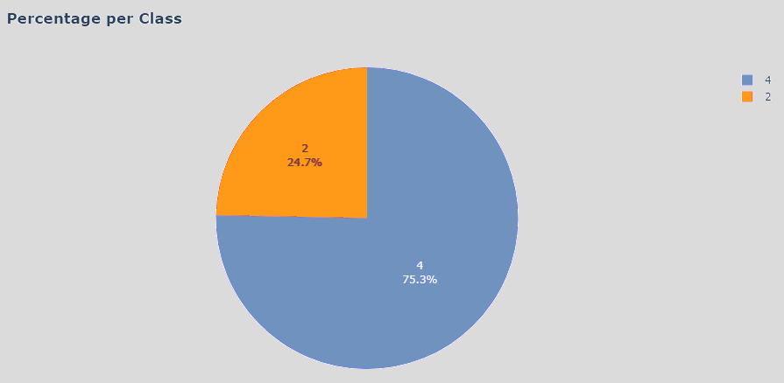
DATA PREPARATION
For this project, I have sourced the breast cancer dataset from Kaggle (Pmotta - 2021, June 6). This dataset provides the essential features required for conducting a comprehensive analysis.
A few steps performed for prepping the dataset for modeling are as follows.
Renaming columns to enhance accessibility and clarity.
Identify data classification by “Class” columns. The dataset is divided into benign and malignant classes.
The examination unveiled a disparity within the dataset, where 75.3% of instances were classified as malignant and 24.7% as benign. A technique called SMOTE - Synthetic Minority Oversampling Technique was implemented. SMOTE generates synthetic instances for the minority class, thus balancing the dataset.
Notes:
To embark on this journey, I have sourced a comprehensive breast cancer dataset from Kaggle. This dataset furnishes the necessary features for conducting a thorough analysis.
In preparing the dataset, several crucial steps were taken:
Columns were renamed to improve accessibility and clarity.
The "Class" column in the dataset was used to identify data classification, dividing the dataset into benign and malignant classes.
This exploration revealed an imbalance within the dataset, with 75.3% of instances classified as malignant and 24.7% as benign. To tackle this, SMOTE (Synthetic Minority Oversampling Technique) was employed, which effectively balanced the dataset. SMOTE generates synthetic data to balance the representation of both classes.
Additionally, various checks, such as identifying duplicates and missing data, were carried out to ensure the completeness and accuracy of the data.
These steps lay the foundation for a robust and reliable dataset, crucial for accurate analysis and model development.

Slide 4
MODELS
Decision Tree Classifier
Optimal max_depth determination through cross-validation was performed.
Random Forest Classifier
KNN Classifier
Parameter tuning and accuracy enhancement were performed.
Notes:
Three classification models were employed in this study:
Decision Tree Classifier
Random Forest Classifier and
KNN Classifier
Optimization techniques were applied to these models to ensure their accuracy and effectiveness in breast cancer prediction.
Evaluation methods are essential to gauge the effectiveness and reliability of the models in accurately predicting breast cancer cases.
Metrics such as ROC-AUC scores and accuracy were utilized to measure the models' ability to distinguish between benign and malignant cases.
For a deeper understanding of the models’ performance across different aspects of prediction. precision, recall, and F1-scores were explored.
Comparative analysis played a pivotal role in determining which model excels in predictive accuracy and precision. Through the assessment of these metrics, valuable insights into the respective strengths and weaknesses of each model were obtained, thus aiding in the identification of the optimal approach for breast cancer prediction.
Furthermore, due consideration was given to potential limitations and ethical considerations inherent to predictive models in the medical realm. This thorough evaluation ensures that the models not only exhibit accuracy but also serve as secure and dependable tools, capable of making a positive contribution to healthcare practices

Slide 5
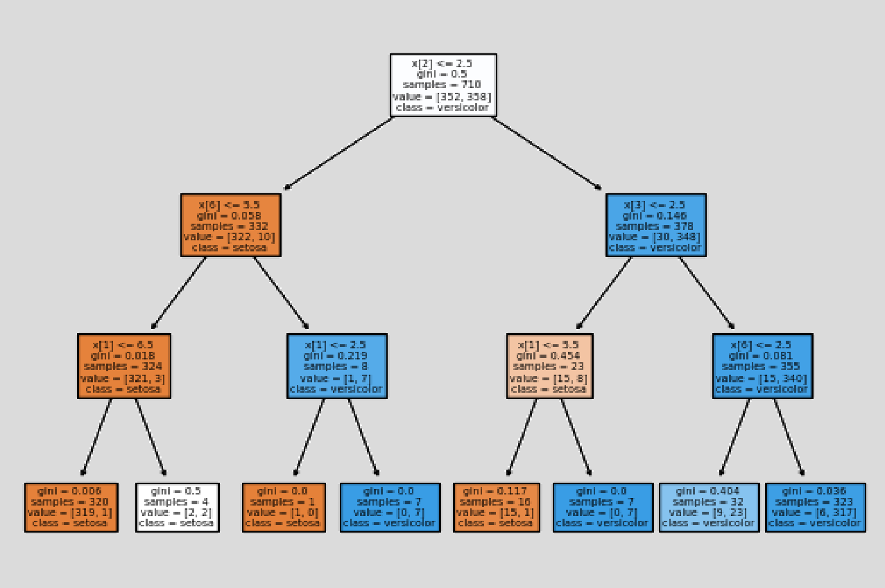
DECISION TREE CLASSIFIER
Optimal max_depth determination through cross-validation was performed to identify the parameters that aid in the best accuracy.
The best accuracy for the model was identified at a max_depth 3.
Notes:
Let's turn our attention to the outcomes achieved by our Decision Tree model. This model, known for its straightforward decision-making process, has been put to the test in predicting breast cancer cases. This model underwent a process of cross-validation to determine the optimal max_depth parameter, yielding an accuracy peak at a max_depth of 3.
Let’s now delve into the results and insights garnered from this particular model's performance.

Slide 6
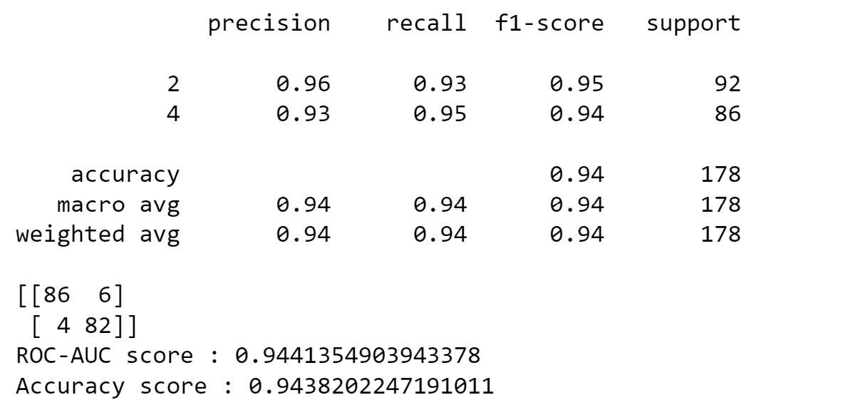
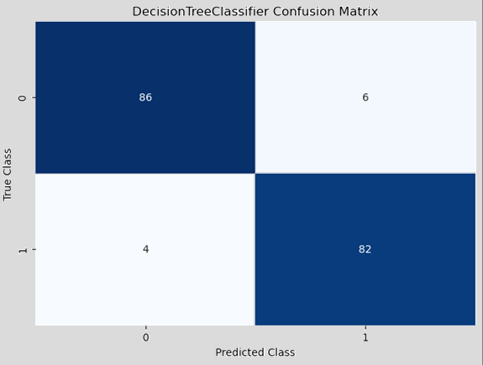
The model performed reasonably well for both classes, with relatively high precision, recall, and F1-score values. It correctly identifies around 96% of benign cases (class 2) and 93% of malignant cases (class 4).
The accuracy of 0.94 indicates that the model correctly predicts around 94% of the instances in the dataset.
Notes:
The macro average F1-score is also 94%, indicating a balanced performance across both classes, benign and malignant.
The confusion matrix reveals the number of true positive, true negative, false positive, and false negative predictions for each class.
For the benign class, there were 86 true positives and 6 false positives. For the malignant class, there were 82 true positives and 4 false negatives.
The ROC-AUC score, which measures the model's ability to distinguish between classes, is 0.944, indicating good discriminatory power.
The overall accuracy of the model is 94%, implying that it correctly predicts 94% of the instances in the dataset.
This analysis showcases the model's strong performance in predicting both benign and malignant cases, with balanced precision, recall, and F1-score values.
Moving forward, the next model outcome we’ll see is the Random Forest model. Renowned for its ability to harness the collective wisdom of multiple decision trees, the Random Forest model has undergone rigorous testing to predict breast cancer cases. Let's uncover the insights and achievements stemming from the Random Forest model's performance.

Slide 7
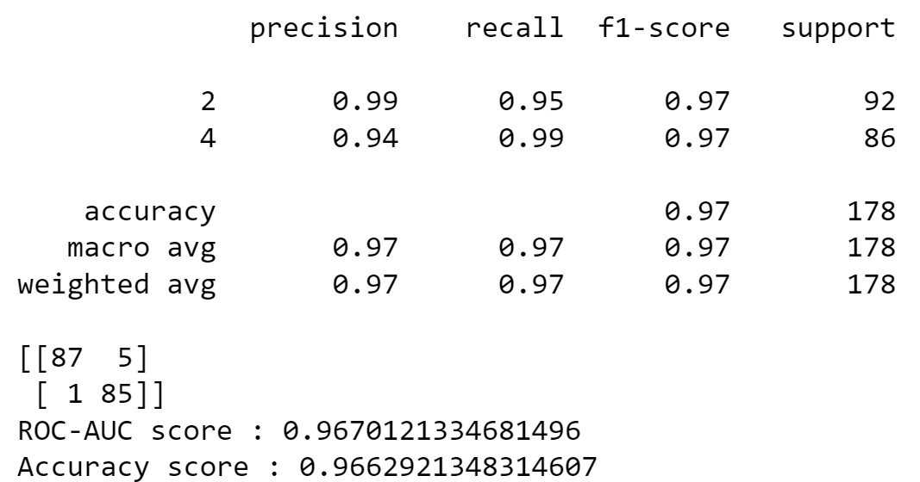

RANDOM FOREST CLASSIFIER
For predicting cases of benign tumors (class 2), the model has a high precision (0.99), meaning that when it predicts a tumor as benign, it is correct 99% of the time.
The accuracy of 0.97 indicates that the model correctly predicts around 97% of the instances in the dataset.
Notes:
The macro average F1-score, reflecting the balanced performance across both classes, stands at 97%.
The confusion matrix provides insights into the model's predictions:
For the benign class, there were 87 true negatives and 5 false positives.
For the malignant class, there was 1 false negative and 85 true positives.
The ROC-AUC score is 0.967, showing strong discriminatory power.
The Random Forest model showcased high precision in predicting benign tumors and exhibited slightly lower precision but higher recall in predicting malignant tumors. The overall accuracy reached an impressive 97%, highlighting the model's efficacy in predicting instances within the dataset.
Next in line is the outcomes yielded by the KNN (K-Nearest Neighbors) model. This model, operating on the principle of similarity, has been applied to our breast cancer prediction task. Let’s explore the results and revelations stemming from the KNN model's performance, shedding light on its role in our quest for accurate predictions.

Slide 8
KNN - KNeighbors Classifier
GridSearchCV was employed to determine the optimal parameters value for the best accuracy.
The parameters identified are -
weights='uniform’
metric= 'hamming’
n_neighbor=5
Notes:
To enhance the performance of our KNN (K-Nearest Neighbors) model, an advanced technique called GridSearchCV was employed.
This technique empowers us to fine-tune the model's parameters, optimizing its predictive capabilities.
Utilizing the power of GridSearchCV, the impact of different parameters on our KNN model was explored.
Through this process, we identified the optimal combination of parameters that significantly enhanced the model's accuracy and performance.
The parameter settings that emerged as the most effective include:
Weighting Scheme: 'Uniform'
Distance Metric: 'Hamming'
Number of Neighbors: 5
These settings were carefully selected to fine-tune our KNN model, resulting in improved predictive capabilities. Let's uncover how these parameter adjustments influenced the model's outcomes and contributed to our pursuit of accurate breast cancer prediction.

Slide 9
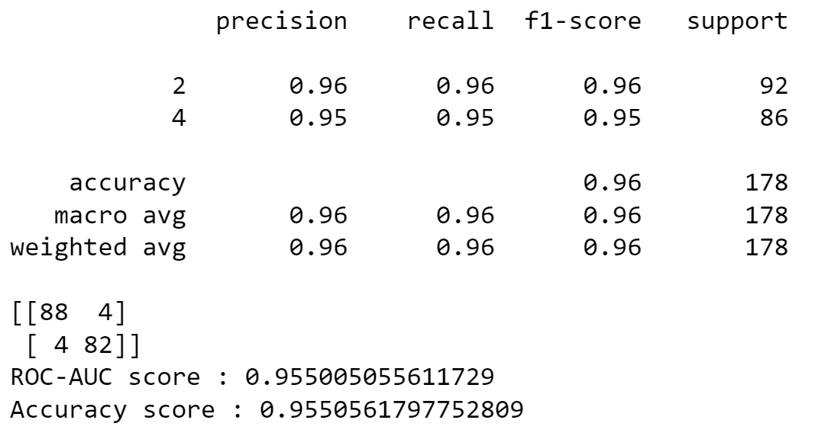
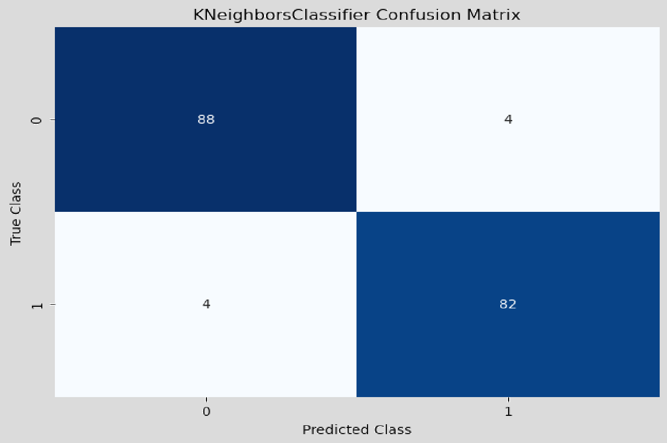
KNN - KNeighbors Classifier
The KNN model performs well for both classes, with high precision, recall, and F1-score values.
The accuracy of 0.955 indicates that the model correctly predicts around 96% of the instances in the dataset.
Notes:
The KNN model performs well for both classes, with high precision, recall, and F1-score values.
The macro average F1-score, reflecting the balanced performance across both classes, stands at 0.96.
It correctly identifies around 96% of benign cases (class 2) and 95% of malignant cases (class 4).
The confusion matrix indicates that there were 4 false positive predictions and 4 false negative predictions.
The ROC-AUC score, is 0.955, showing strong discriminatory power.
The overall accuracy of the model is impressive at around 0.955 which signifies that it correctly predicts around 96% of instances in the dataset.

Slide 10
MODELS OUTCOME
METRIC | RANDOM FOREST CLASSIFICATION |  | KNN – KNEIGHBORS CLASSIFIER |  | DECISION TREE
 | Benign | Malignant | Benign | Malignant | Benign | Malignant
PRECISION | 0.99 | 0.94 | 0.96 | 0.95 | 0.96 | 0.93
RECALL | 0.95 | 0.99 | 0.96 | 0.95 | 0.93 | 0.95
F1-SCORE | 0.97 | 0.97 | 0.96 | 0.95 | 0.95 | 0.94
ROC-AUC SCORE | 0.967 |  | 0.955 |  | 0.944
ACCURACY SCORE | 0.966 |  | 0.955 |  | 0.943
Notes:
Now, let's visually compare the performances of our models through a comprehensive table. This table will provide a clear overview of key metrics such as accuracy, precision, recall, and F1-scores for each model—Random Forest, Decision Tree, and KNN. This side-by-side comparison will shed light on how each model excels in different aspects of breast cancer prediction, enabling us to make informed conclusions about their effectiveness.

Slide 11
CONCLUSION
Our central aim is to analyze the breast cancer dataset and create a predictive model. Through the construction and comparison of various models, we sought to pinpoint the most effective approach. The implemented models - RandomForest, DecisionTree, and KNN - all exhibit strong performance, yielding accuracy scores ranging from 94% to 97%. Notably, the Random Forest and KNN models showcase slightly elevated precision, recall, and F1-scores in comparison to the Decision Tree.
In essence, all models effectively predict breast cancer, with Random Forest and KNN displaying marginally superior performance, while the Decision Tree remains a competitive contender.
Notes:
As we wrap up, our journey was all about analyzing a breast cancer dataset and building models to predict it. We used RandomForest, DecisionTree, and KNN models to find the best way. Metrics like ROC-AUC and accuracy scores show how well models can tell different cases apart. All three models did well, with accuracy between 94% and 97%. The Random Forest and KNN models stood out a bit more with slightly better precision, recall, and F1-scores.
In this mix of models, each one proves it can predict breast cancer well. The Random Forest and KNN models shine a bit more, while the Decision Tree is also good.

Slide 12
Limitations
The study relies on a limited and potentially outdated dataset. A more recent and comprehensive dataset could provide a more accurate representation of current trends and factors influencing breast cancer prediction. Additionally, the dataset's features might not capture all relevant factors that contribute to breast cancer prediction. Additional clinical, genetic, or lifestyle-related features could enhance the model's accuracy.
Risk
Predictive models in the medical domain pose a risk of false positives (classifying benign as malignant) and false negatives (missing malignant cases). False positives could trigger unnecessary distress and invasive procedures, straining healthcare resources. False negatives may lead to delayed treatment, harming patient outcomes and intervention efficacy. Thorough testing is vital to minimize these risks and ensure patient well-being.
Notes:
As we draw our journey to a close, we find ourselves at a juncture where data science and healthcare intertwine. Our expedition into the realm of breast cancer prediction has illuminated the potential of predictive modeling in transforming medical diagnostics. The models, each with its own strengths, have showcased the promise of precision and accuracy in identifying cases of breast cancer.
However, as we navigate the path forward, it's imperative to recognize that our journey is far from over. With every triumph, there are challenges and responsibilities. The road ahead includes refining our models, expanding datasets, and ensuring ethical deployment to benefit patients without undue harm.

Slide 13
THANK YOU!
Notes:
In closing, I invite you to contemplate the profound impact that data-driven healthcare can have on individuals' lives. We're at a special place where data meets our human needs. Remember, every prediction our models make could mean saving lives, giving patients more control, and changing how we take care of health.
Thank you for being part of this amazing journey with me.

Slide 14
REFERENCES
Pmotta - 2021, June 6. Breast cancer prediction. Kaggle - https://www.kaggle.com/code/pmotta/breast-cancer-prediction/input
Patel, J., Patel , U., Patel, R., & Shah, P. (2019, April 28). Breast Cancer Analysis. https://rstudio-pubs-static.s3.amazonaws.com/491489_b86f191488ab4ed0a37e7a95c839a8f4.html

